Slide 1


TPMS Products
Automotive electronics R&D, production and sales integration enterprise
Shanghai Autotec International Corp.
Focusing on intelligent electronic high-tech as the core competitiveness, we are deeply engaged in the automotive electronics industry.

Slide 2
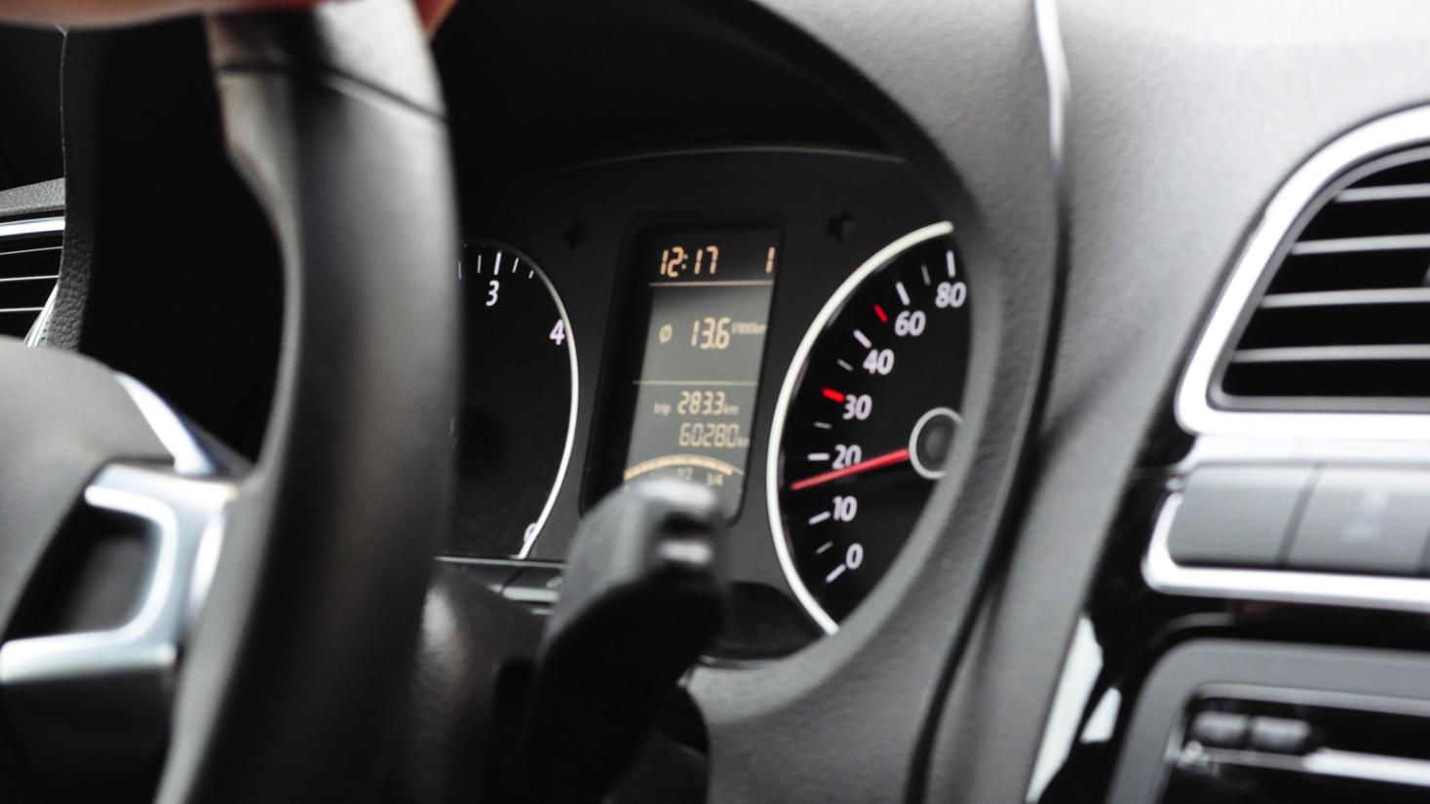
Catalog
1
TPMS Program Introduction
2
Receiver Controller
3
Tire Pressure Monitoring Sensor
4
Quality Control
Production capacity and automated production lines
5
6
Delivery Experience

Slide 3

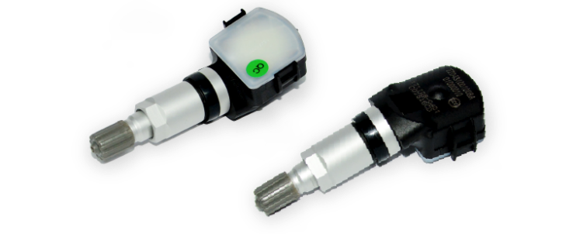
TPMS Solution Introduction
Our TPMS solution
At present, our TPMS system can meet the needs of various OEMs and realize CAN communication with different OEMs.
We can provide complete solutions for 4-wheeled and 6-wheeled vehicles.
Support to provide TPMS system alone (provide sensor and receiver), or combined with other in-vehicle equipment (only provide sensor).
Have automated production lines with strong supply assurance capability.
Supports the realization of advanced functions such as UDS diagnosis according to the requirements of different OEMs.
Can realize four-wheel automatic positioning function (need vehicle ABS signal to cooperate).
Support one-way system and two-way system for customers to choose freely.

Slide 4

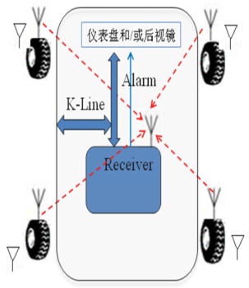
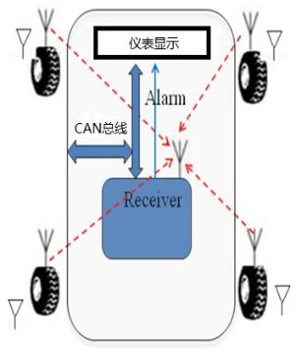
Three Ace Products
System Composition Program
A program
Program B
Unidirectional system
Bidirectional systems
Sensor
Sensors
Receiver Controller
Receiver Controller
CAN Bus
K-LINE
Low Frequency Trigger
CAN bus
LIN

Slide 5
Catalog
1
TPMS Program Introduction
2
Receiver Controller
3
Tire Pressure Monitoring Sensor
4
Quality control
Production capacity and automated production lines
5
6
Supply Experience

Slide 6
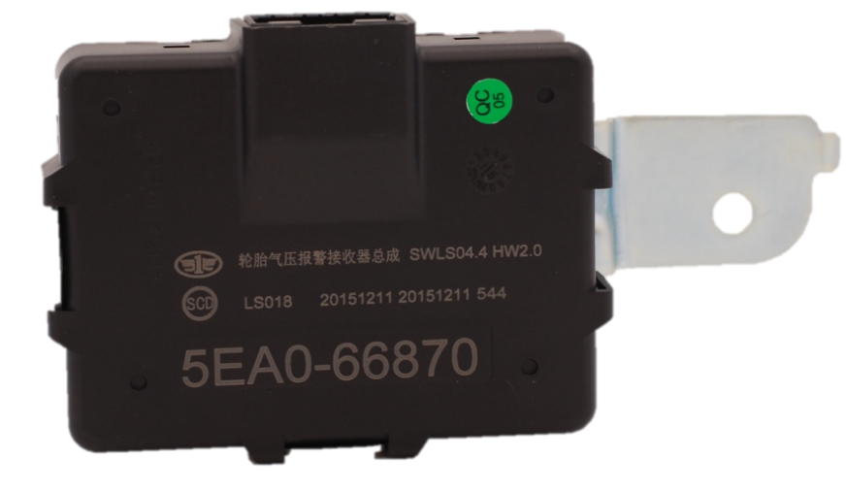
Passenger Car Receiver Controller
Passenger Car Receiver Controller - 16pin connector

Slide 7
Passenger Car Receiver Controller
Interface definition
The interface includes basic function/communication interfaces such as power supply, communication, ignition switch, etc. Other types of interfaces can also be added according to the customer's requirements; the connector model can also be changed to the customer's specified model.
Serial number | Function | Signal Characteristics
X1:1 | BAT+ | Power input
X1:2 | IGN_ON | IGN signal, high active
X1:3 | CANH | CAN communication signal
X1:4 | CANL
X1:5 | / | Reserved
X1:6 | / | Reserved
X1:7 | / | Reserved
X1:8 | / | Reserved
X1:9 | GND | Ground
X1:10 | / | Reserved
X1:11 | / | Reserved
X1:12 | / | Reserved
X1:13 | / | Reserved
X1:14 | / | Reserved
X1:15 | / | Reserved
X1:16 | / | Reserved

Slide 8
Passenger Car Receiver Controller
Controller Basic Functions
Serial number | Function | Detailed description
1 | Power on self-test | Whether the receiver is working normally and whether the communication is smooth.
2 | Rapid air leakage alarm | The airpressure decreases at a rate of more than9KPa within 8 seconds, and an alarm is issued within the specified time.
3 | Underpressure alarm | The air pressure is lower than 75% of the regulation, the alarm will be issued within the specified time.
4 | Overpressure alarm | The air pressure is higher than 125% of the regulation, the alarm will be issued within the specified time.
5 | High tire temperature alarm | Tire temperature exceeds the set value, the alarm will be issued within a specified period of time.
6 | System failure alarm | System failure alarm is issued after 10min.
7 | Alarm priority | Fault alarm is preferred to tire pressure alarm, rapid air leakage is preferred to low pressure alarm to high pressure alarm.
8 | Can bus communication | CAN2.0A, high speed CAN baud rate 500Kbits/S, meet ISO11898 standard;CAN controller chip TJA1042;

Slide 9
Passenger car receiver controller
Basic performance of passenger car receiver controller
No. | Basic items | Specific requirements | Remarks
1 | Voltage | Rated voltage 12V | Operating voltage 9-16V (passenger car)
2 | Maximum quiescent current | <0.1mA
3 | Operating Current | <100mA
4 | Operating Temperature | -40℃~+85℃
5 | Storage Temperature | -40℃~+95℃
6 | Receiving Sensitivity | >-105dBm
7 | Carrier Frequency | 433.92MHz | ±100Khz
8 | Protection Class | IP5X | B-pillar, C-pillar, trunk
9 | System Design Life | 15 years or 250,000 kilometers
10 | Installation | Vehicle interior | B-pillar, C-pillar, trunk

Slide 10
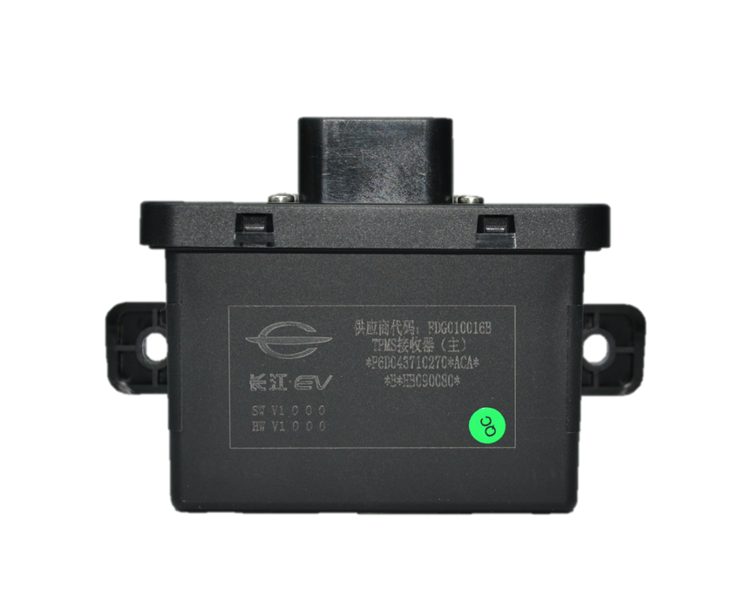
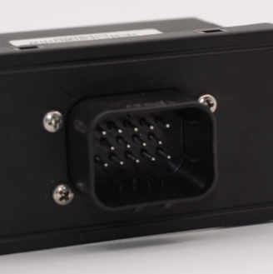
Commercial Vehicle Receiver Controller
Commercial Vehicle Receiver Controller-14pin connector
Adopting waterproof connector, O-ring is added between the top cover and the shell, which can reach the waterproof rating of IP67, mounted on the floor of the vehicle, suitable for longer commercial vehicles;

Slide 11
Commercial Vehicle Receiver Controller
Difference between passenger car and commercial vehicle receiver controllers
Serial number | Basic items | Specific requirements | Remarks
1 | Voltage | Rated voltage 12V | Operating voltage 9-16V (passenger car)
 |  | Rated voltage 24V | Operating voltage 16-32V (commercial vehicles)
2 | Maximum quiescent current | <0.1mA
3 | Operating Current | <100mA
4 | Working Temperature | -40℃~+85℃
5 | Storage Temperature | -40℃~+95℃ | ±100Khz
6 | Receiving Sensitivity | >-105dBm
7 | Carrier Frequency | 433.92MHz
8 | Protection Class | IP5X
9 | System Design Life | 15 years or 250,000 kilometers

Slide 12
Passenger Car Receiver Controller
Hardware Solutions
Power Supply Chip
MCU
Module
RF Receiver Module
CAN Communication Module

Slide 13
Passenger Car Receiver Controller
Hardware performance design
In order to ensure that the receiver controller meets the electrical performance requirements, the circuit design takes into account various aspects, mainly reflected in the following aspects.
Electronic components: vehicle-grade products are selected;
Each port meets the requirements of short circuit to ground and power supply, while the power port meets the requirements of reverse connection;
The power line focuses on conduction emission and radiation emission, and the loop is as small as possible in PCB alignment;
Each port anti-static design, while preventing signal transients and radiated interference conducted by the harness;
MCU power supply focus on decoupling to reduce radiated emissions;
Periodic refreshing of each enable port to enhance immunity to interference;
Ensure that the ground wire surrounds all alignments and that the ground wire is connected in a grid with no antenna-like copper overlay.

Slide 14
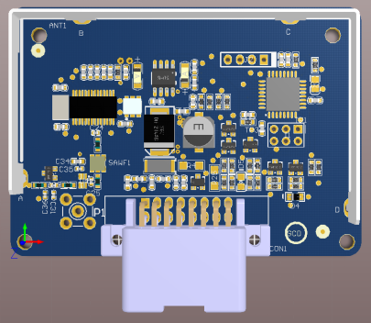
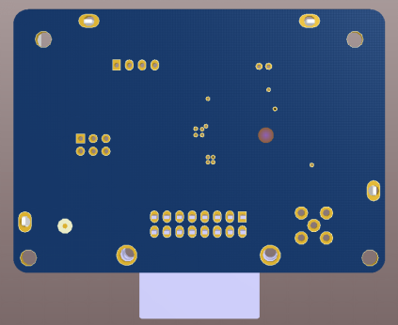
Passenger Car Receiver Controller
Capacitors for the input interface are laid out close to the connector for fast surge voltage protection, spike pulse filtering, and ESD protection.
The TVS device of the input power supply is placed close to the connector so that the ground pin of the TVS is close to the ground of the connector to realize the purpose of fast discharge.
The crystal oscillator circuit is wrapped around the ground to prevent the crystal oscillation signal from interfering with other circuits.
MCU power supply filter capacitors are placed adjacent to the MCU power supply pins to quickly filter out power supply noise and provide clean and stable power supply for the MCU.
The CAN circuit is wired in strict accordance with the standard circuit layout, and the TVS and filter capacitors are placed close to the connector, which can quickly eliminate spike pulses and static electricity as well as filter out stray waves to ensure the stable and reliable operation of the CAN circuit.

Slide 15
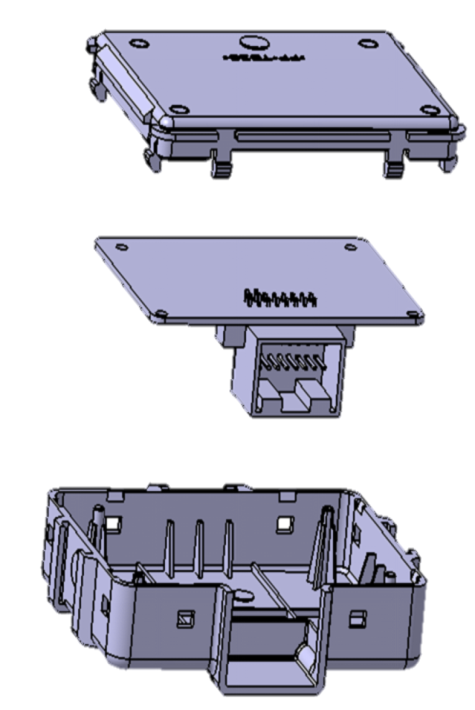
Passenger Car Receiver Controller
3D Assembly Diagram

Slide 16
Catalog
1
TPMS Program Introduction
2
Passenger Car Receiver Controller
3
Tire Pressure Monitoring Sensor
4
Mass Control
Production capacity and automated production lines
5
6
Supply Experience

Slide 17
Tire Pressure Sensor
Sensor performance
I. Basic Performance
No. | Basic items | Specific requirements | Remarks
1 | Battery Voltage | 2.2V~3.6V | Rated: 3V
2 | Battery Power | 210MAH | Factory Battery Voltage: 2950mV
3 | Working life | 100,000 kilometers or 6 years | The life span of each operating mode will be different depending on the firing cycle.
4 | Measuring Temperature | -40℃~125℃
5 | Measuring Pressure | 0KPa~900KPa OR 0KPa~1900KPa
6 | Transmission Frequency | 433.92MHZ
Measurement Performance
 | Basic items | Range | Error
1 | Pressure | 100~500kpa | 0℃~70℃, error ±5kpa -40℃~0℃/70℃~125℃, error ±10kpa
 |  | 500~900kpa | 0℃~70℃, error ±7kpa -40℃~0℃/70℃~125℃, error ±15kpa
2 | Temp. | -20℃~70℃ | ±2℃
 |  | -40℃~-20℃, 70℃~125℃ | ±3℃

Slide 18
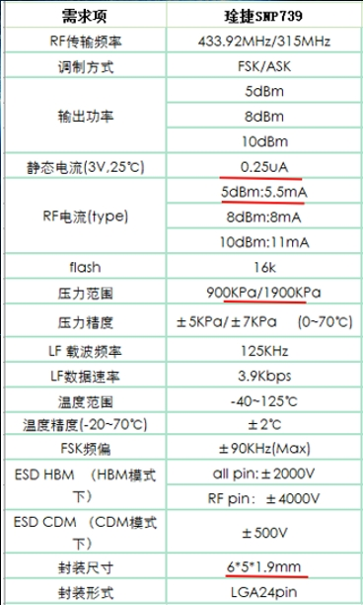
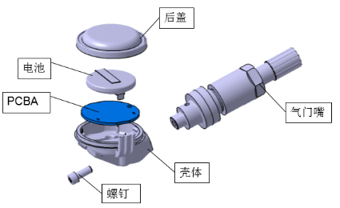
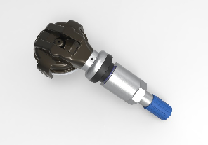
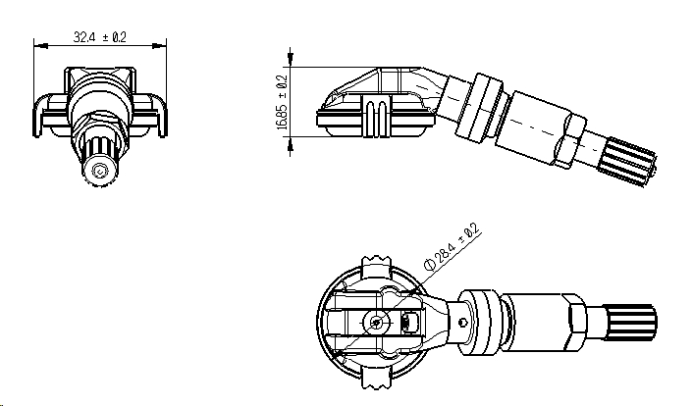
Tire Pressure Monitoring Sensor
Tire Pressure Monitoring Sensor

Slide 19
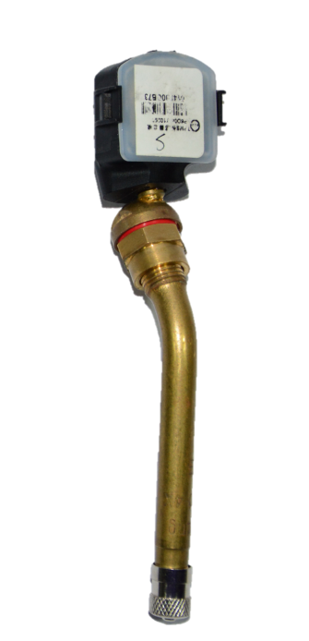
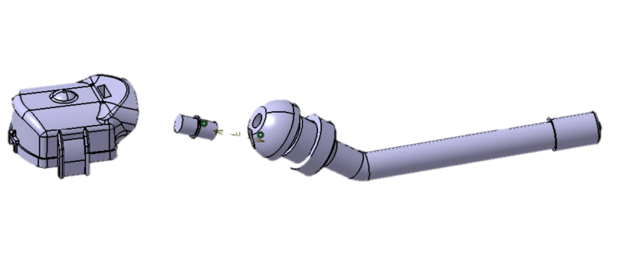
Tire Pressure Monitoring Sensor
Commercial Vehicle Sensor

Slide 20
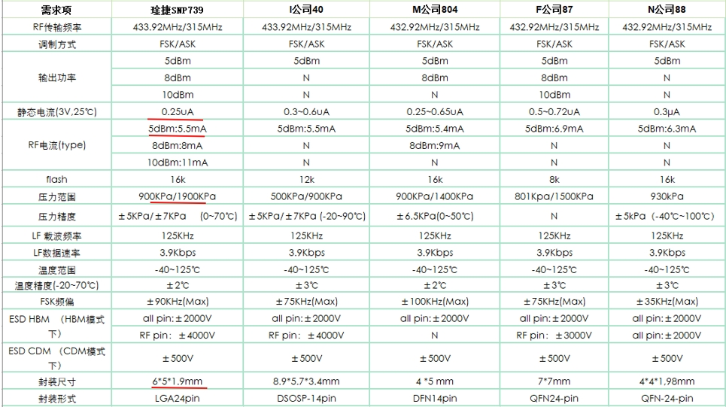
Tire Pressure Monitoring Sensor
Infineon SP40
MLX91804
Freescale FXTH87
Domestic Cynthia Jie chips, stable supply;
Sensor chip performance is on par with imported chip models, some performance exceeds;
Low chip cost;
Chip company is located in China, perfect technical support;

Slide 21
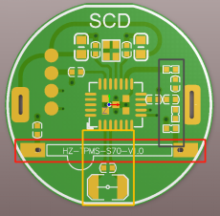
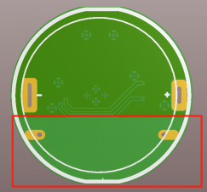
Tire Pressure Sensor
Hardware Performance Design
In order to ensure that the sensor meets the electrical performance requirements, the circuit design takes into account all aspects, mainly in the following areas.
Electronic components: choose vehicle-grade products;
This sensor adopts LOOP antenna, keeping absolute headroom under the antenna;
RF signal line focuses on the consideration of conduction emission and radiation emission, in the PCB alignment as short as possible and do not have sharp turns;
RF alignment and power lines, signal lines, clock lines non-parallel alignment, reduce electromagnetic radiation;
Low-frequency inductor to maintain absolute headroom below, because the low-frequency inductor is used as an antenna needs to be away from chips, crystals and other metal parts, and try to place by the edge;
Low-frequency circuit alignment selection of differential distribution line form;
Ensure that the ground line surrounds all the wires, and the ground line is connected to the grid, no antenna-like copper.

Slide 22
System Architecture
Power supply
2032 button battery
Hardware framework design
Low Frequency Module
LF:125KHZ
MCU
Pressure Sensor
Temperature Sensor
Acceleration Sensor
High Frequency Module
RF:433.92MHZ
Clock Module
First power-up
Memory Mode
P 10S
T 240S
A NA
RF NA
Stationary Mode
P 6S
T 120S
A 12S
RF 180S
Software Framework Design
Pressure consistently greater than 100KPa for more than 3 minutes
Pressure change less than 9KPa in 8 seconds
Static detected
Motion detected
Pressure change greater than 9KPa in 8 seconds
Operating Mode
P Pressure detection cycle
T Temperature detection cycle
A Motion detection cycle
RF Data Transmission Cycle
Alarm Mode
P 1S
T 60S
A NA
RF 1S
Motion Mode
P 6S
T 12S
A 16S
RF 60S
Pressure change greater than 9KPa in 8 seconds
Pressure change less than 9KPa in 8 seconds

Slide 23
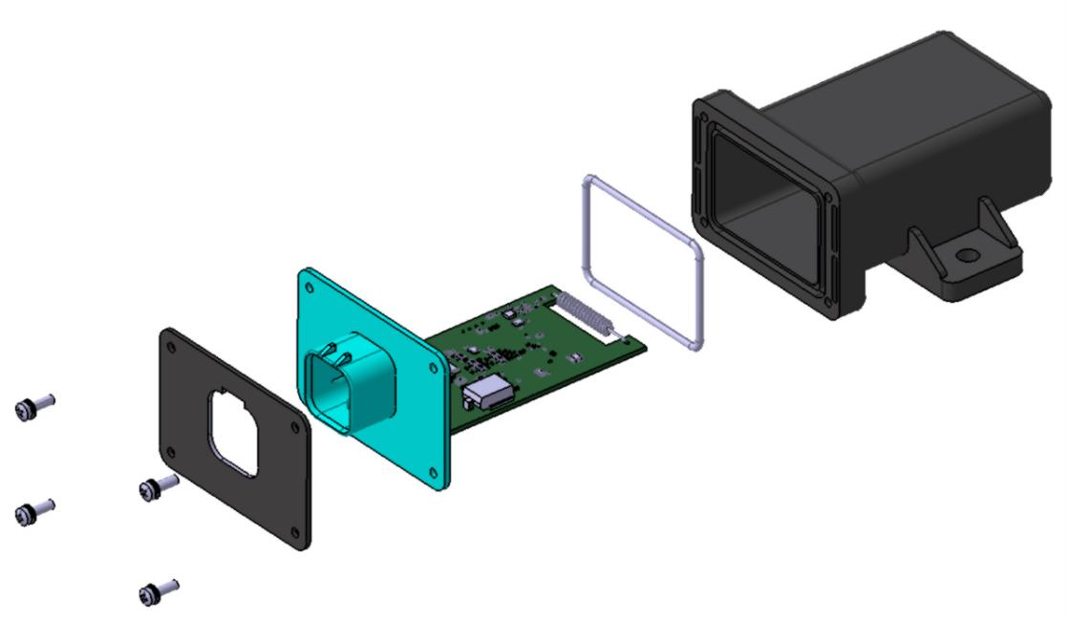
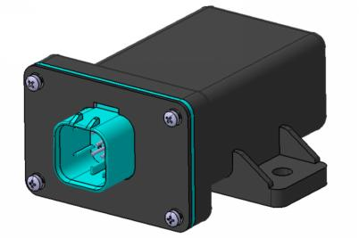
DZ97189716928 (23.4.1) Main controller 500K
P00000512
Casing
P30001110
P30001111
O-ring
P30001112
Plug
P30001113
P10000409
Antenna
Metal stopper
PCBA
P30001114
Combination screws
M3*10

Slide 24
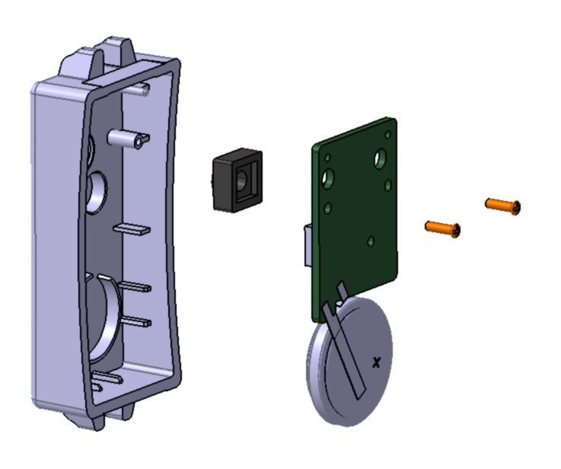
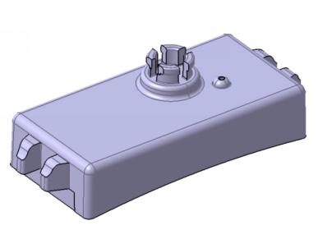
DZ97189716661 Integrated Tire Pressure Monitoring Sensor
P00000503
P30001109
Housing
P10000408
P30001117
PCBA
Silicon pad
P30001118
M1.7*6 Self-tapping screw
Battery
P20001449

Slide 25
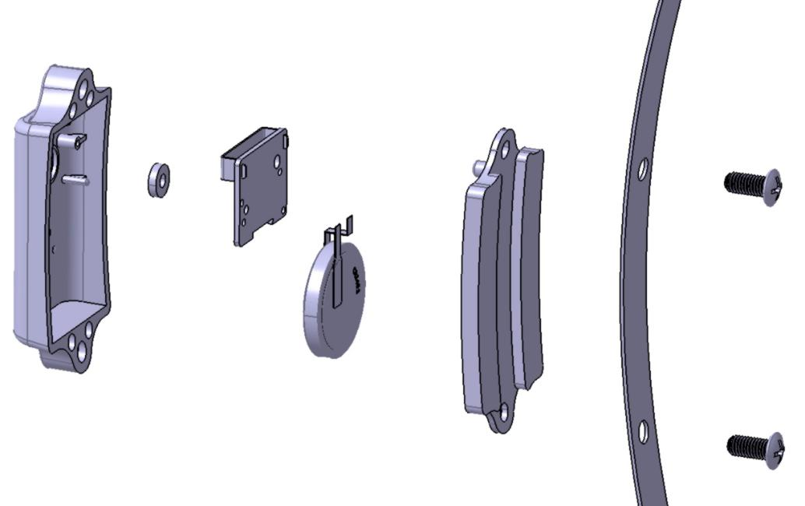
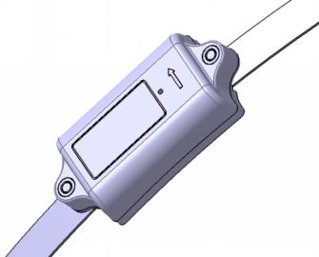
DZ97189716662 (23.4.1) strap-on tire pressure monitoring sensor
P00000504
P30001118
Housing
M1.7*6 Self-tapping screw
P30001119
P30001121
P30001122
P10000410
P30001120
PCBA
Back Cover
Strap
Silicon Pad
Screws
M4*10
P30001123
Antenna
Battery

Slide 26
Catalog
1
TPMS Program Introduction
2
Passenger Car Receiver Controller
3
Tire Pressure Monitoring Sensor
4
Mass Control
Production capacity and automated production lines
5
6
Delivery Experience

Slide 27
Quality Control
Our laboratory has independent tripartite testing qualification, passed CMA and CNAS certification, currently has more than 100 sets of test equipment, mainly covering the following tests.
We mainly cover the following tests:
• Xenon-arctest• Vibration test
• Neutral salt spray test • Water Proofing test
• Acetic acid salt spray test • Condensation test
• Precision dimension measurement • Mechanical shock test
• Anechoic Chamber • Gravel impact test
Lifetime test • Lifetime test • High Current/Voltage test
• High/Low temperature storage test • Colorimeter Test
• High/Low temperature operation test • Combustion test
• Temperature & Humidity cycle test • Drop Test
• Temperature shock test • Insulation Resistance test
• Pressure cooking test • All EMC test All EMC test

Slide 28
Quality Control
1. the antenna is completely built-in and isolated from the outside world;
2. the hardness of the gasket is (50-60) HA, and flame retardant is added, so the sealing is better;
3. the gasket is enlarged and the limit groove is added, so as to ensure that the gasket is not displaced and to realize the automated production lineassembly;
4. Adopting PCBA integrated antenna, automated production line robot assembly, the whole process without human involvement in assembly, and improve the yieldrate;

Slide 29
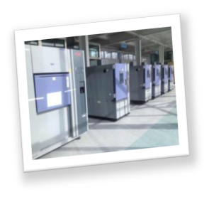
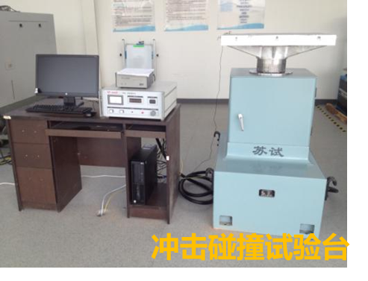
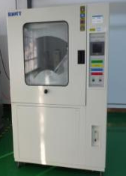
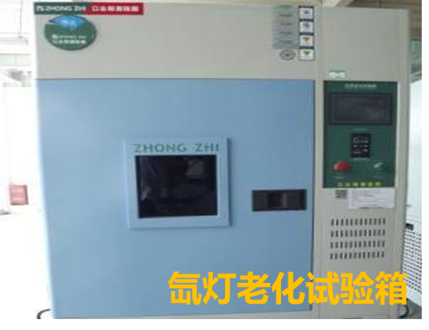
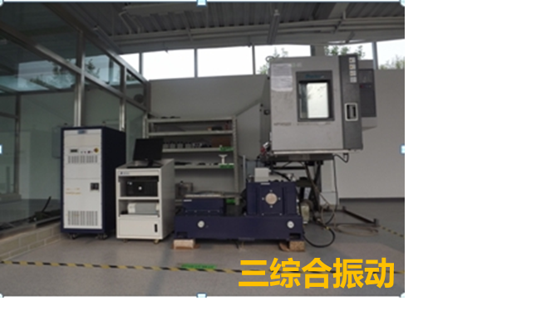
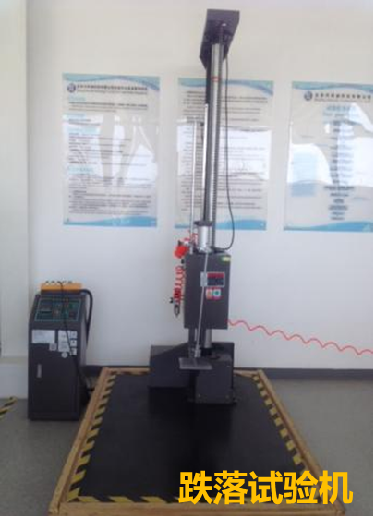
Quality Control
Reliability equipment

Slide 30
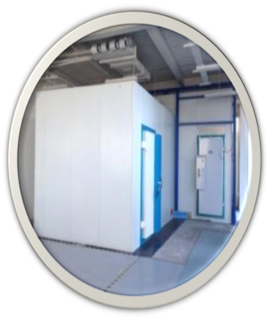
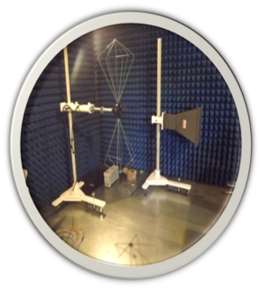
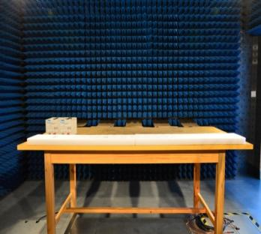
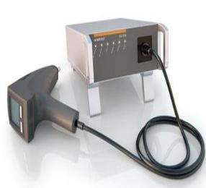
Quality Control
EMC Laboratory

Slide 31
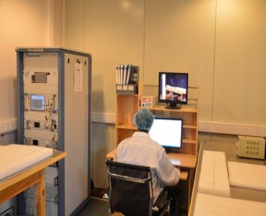
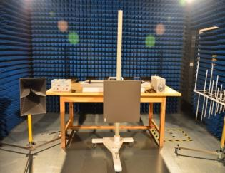
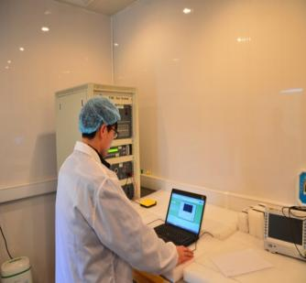
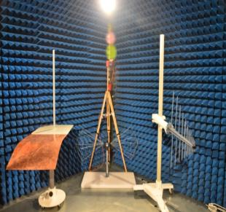
Quality Control
EMC Laboratory
Electrostatic Discharge Test System
Transient Conducted Immunity Test System
Electric Field Radiation Immunity Test System
Emitter detection pressure value is small
Electric Field Radiated Emission Test System

Slide 32
Catalog
1
TPMS Program Introduction
2
Receiver Controller
3
Tire Pressure Monitoring Sensor
4
Quality Control
5
Production capacity and automated production lines
6
Supply Experience

Slide 33

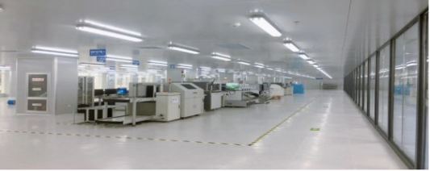
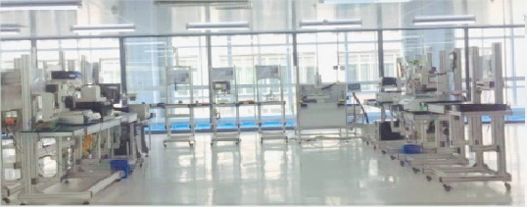
Production capacity - production workshop
SMT Workshop
Assembly Workshop
Equipped with the world's most advanced SMT production equipment, the product craft is more exquisite.
Flexible U-shape production line set up, can adapt to the small batch, multi-species production and assembly.

Slide 34
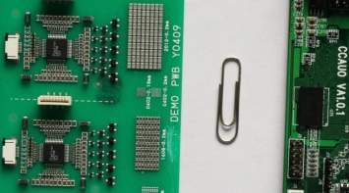
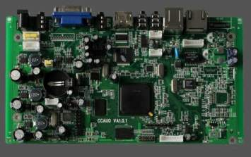
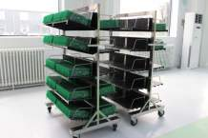
Production capacity--Precision PCB board welding
Curved pin
ϕ0.9mm
0.025mm welding precision, the smallest can weld 01005 devices
Able to complete a variety of complex processes of PCB welding

Slide 35
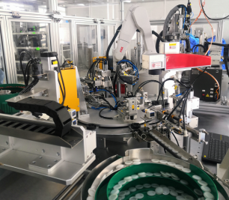
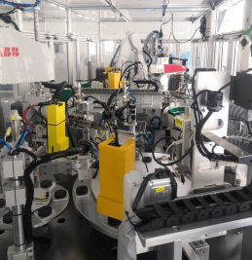
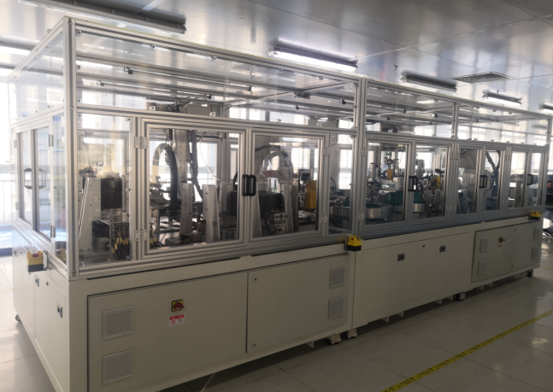
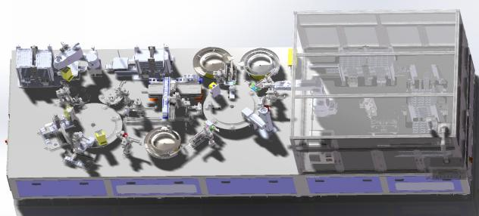
Automated production line
Automated production line 12S / only, according to 8 hours a day, 250 working days a year. The annual output is 600,000pcs.
Manual assembly 40S/pc, according to 8 hours a day, 250 working days a year. Annual output is 180,000 pcs.

Slide 36
Catalog
1
TPMS Program Introduction
2
Receiver Controller
3
Tire Pressure Monitoring Sensor
4
Mass Control
Production capacity and automated production lines
5
6
Delivery Experience

Slide 37


Successful Cases
Tire Pressure Monitoring System (TPMS)
FAW Sedan
Yangtze River Motors (Yige - G20 Conference Special Purpose Vehicle)
FAW Sedan: B70, B50, B90, X80, X40, etc. Batch supply started in October, 2012
Changjiang Auto JAS01 bus (simple design), 1 master, 1 slave two receivers, 6 transmitters. Ordered in March 2014, started small batch supply in July 2015, now bulk supply.

Slide 38

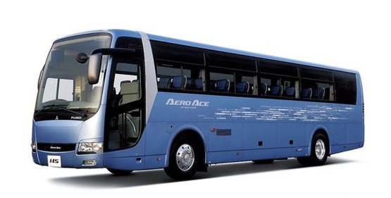
Successful Cases
Tire Pressure Monitoring System (TPMS)
Great Wall Huaguan EG11 electric sports car
Jiangsu Dengda Electric Bus
Great Wall Huaguan EG11 electric sports car: ordered in August 2015 and supplied in small quantities in March 2017
Jiangsu Dengda electric buses: ordered in September 2015 and supplied in small batch in June 2016

Slide 39


Successful Cases
Tire Pressure Monitoring System (TPMS)
Sichuan Mustang
Qingdao Party A light rail train
Sichuan Mustang: T70SUV. Ordered in June 2016, small batch supply started in November 2015 (Note: low-frequency wake-up tire pressure monitoring)
Qingdao Party A light rail train: 32 transmitters 16 receivers/train. Ordered in June, 2014, and started supplying in December, 2015. (Note: light rail train tire pressure monitoring)

Slide 40
Thanks for listening!
!
Shanghai Autotec International Corp.

